Slide 1
STUBBLE AGGREGATION
AND DISPOSAL
TEAM-10
B.SATHVIKA – 100
B.RITHIKA - 088
V.AKSHITHA - 307

Slide 2
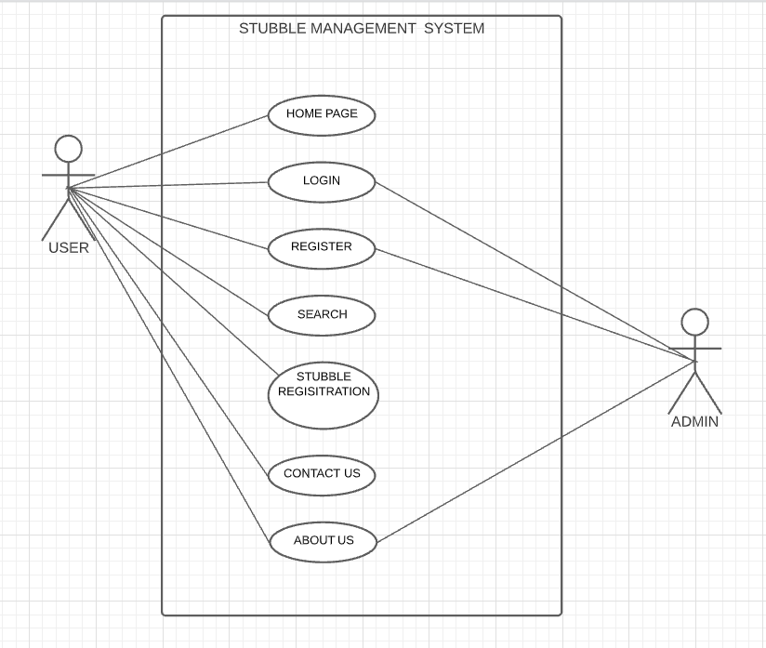
Use Case Diagram:-

Slide 3

It just display about the website and if you want to sell something then login into our website.
HOME PAGE

Slide 4
LOGIN
The fields included in this module are:-
USERNAME
PASSWORD

Slide 5
REGISTER
The fields included in this module are:-
USERNAME
PHONE NUMBER
EMAIL ID
GENDER
PASSWORD

Slide 6
SEARCH
The fields included in this are:-
TYPE OF STUBBLE
PLACE

Slide 7
STUBBLE REGISTRATION
The fields included in this are:-
NAME OF THE STUBBLE
DATE
QUANTITY
ADDRESS TO PICKUP
INDUSTRY NAME
ADDRESS OF INDUSTRY

Slide 8

If you have any queries you can contact to Phone No.XXXXXXXXXX (or) you can mail us to stubble@gmail.com (or) you can reach us to address abc apartment,near manikonda Hyderabad.

Slide 9

a
This module helps people understand about our website clearly.We display how people are getting helped and how much pollution is getting reduced because of this management.

Slide 10

a

